Slide 1

Drupal Blocks

Slide 2

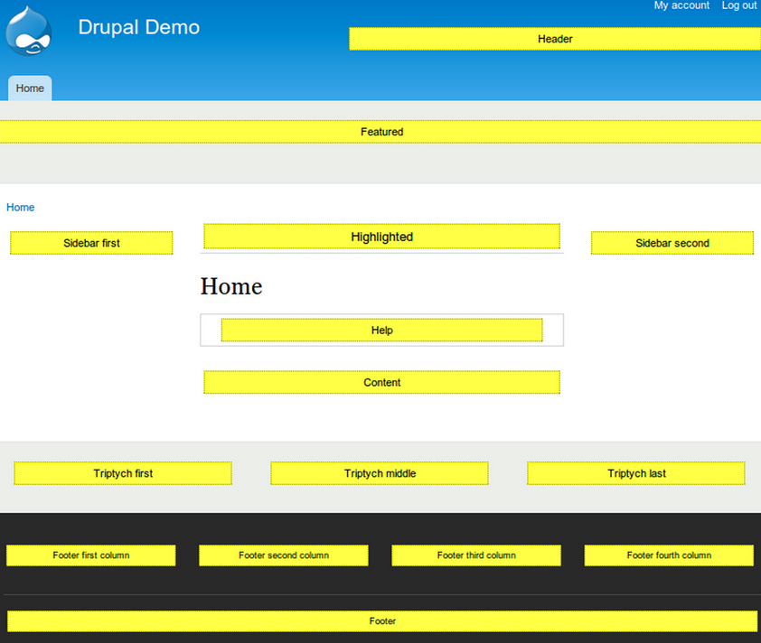
What regions look like
Notes:
So what are we actually DOING?
We’re in the process of organizing an event for the end of Janaury.
We’ll give 9 high schools, 10 tickets each to give to interested high school girls. 10 tickets will be reserved for alternatively educated high school girls.
The event will be 2 days, held at Portland State University. There will be about 7 hands on workshops – and we’ll go more detail into those later.
Then, somewhat unique to ChickTech, we plan to have a structure mentoring approach. Instead of having this be a one-off event, we want to ensure that the participants (who showed interest during the workshops) remain engaged. To do this, we’ll meet with the girls every other month to build on what they learned. We’ll do that for 1 year.
And our plan is to have very little “talking at” and more “doing”.
Next we’ll go into details about workshops. At the end we’ll talk about how you can help.

Slide 3
What is a block?
Technical: Blocks are pieces of information that can be displayed in the regions of your theme. Blocks can take many forms. Usually they are dynamic lists of information or menus.
English: A block is a section of your site with stuff in it. Some common blocks are things like header areas, footers menus, a side menu, or a log-in area.
Notes:
So what are we actually DOING?
We’re in the process of organizing an event for the end of Janaury.
We’ll give 9 high schools, 10 tickets each to give to interested high school girls. 10 tickets will be reserved for alternatively educated high school girls.
The event will be 2 days, held at Portland State University. There will be about 7 hands on workshops – and we’ll go more detail into those later.
Then, somewhat unique to ChickTech, we plan to have a structure mentoring approach. Instead of having this be a one-off event, we want to ensure that the participants (who showed interest during the workshops) remain engaged. To do this, we’ll meet with the girls every other month to build on what they learned. We’ll do that for 1 year.
And our plan is to have very little “talking at” and more “doing”.
Next we’ll go into details about workshops. At the end we’ll talk about how you can help.

Slide 4
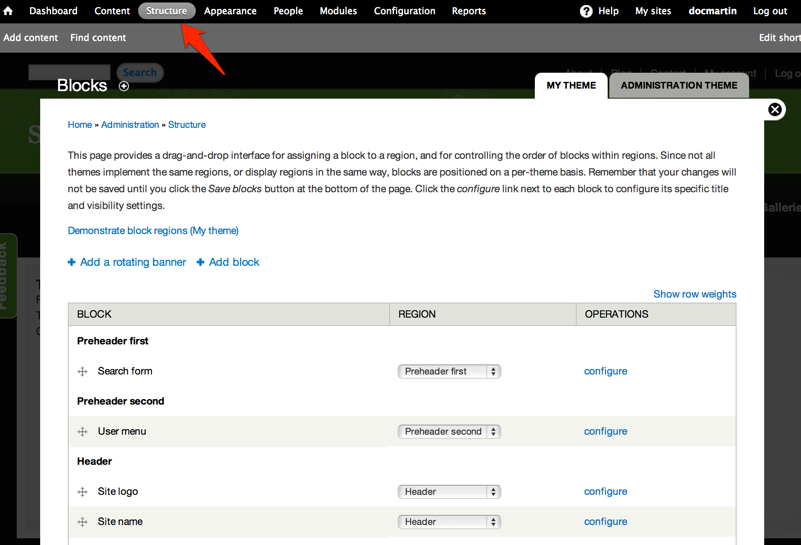
Where do you find blocks?
Admin > Structure > Blocks
Notes:
So what are we actually DOING?
We’re in the process of organizing an event for the end of Janaury.
We’ll give 9 high schools, 10 tickets each to give to interested high school girls. 10 tickets will be reserved for alternatively educated high school girls.
The event will be 2 days, held at Portland State University. There will be about 7 hands on workshops – and we’ll go more detail into those later.
Then, somewhat unique to ChickTech, we plan to have a structure mentoring approach. Instead of having this be a one-off event, we want to ensure that the participants (who showed interest during the workshops) remain engaged. To do this, we’ll meet with the girls every other month to build on what they learned. We’ll do that for 1 year.
And our plan is to have very little “talking at” and more “doing”.
Next we’ll go into details about workshops. At the end we’ll talk about how you can help.

Slide 5
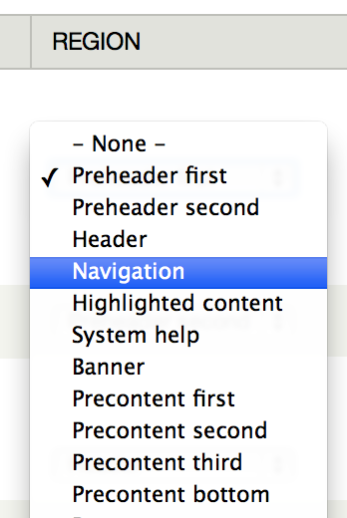
Blocks typically live in regions
Assign a block to a region in the drop down in the middle column.
Notes:
Tom

Slide 6
Adding a block
To add a block, just hit the "Add block" button on the blocks page.
- A description is required.
- A body is required.
Notes:
Tom

Slide 7
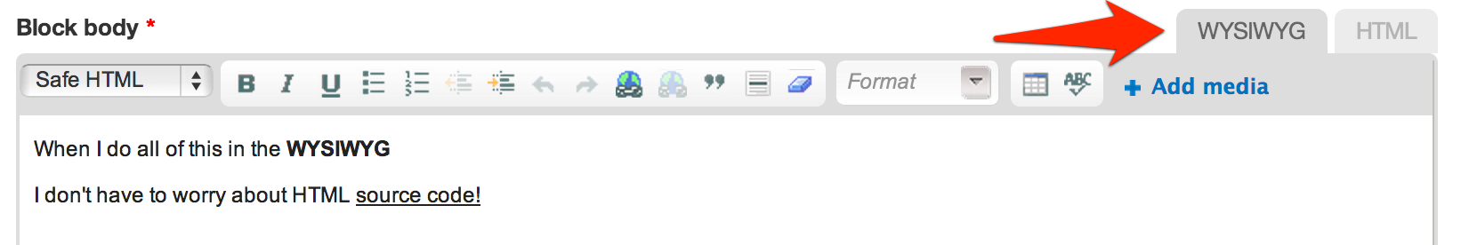
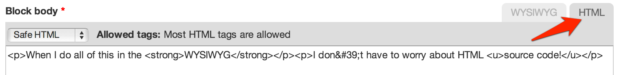
WYSIWYG & HTML
What You See Is What You Get
HyperText Markup Language
Notes:
Ok, here’s the list of each of the workshops. We’ll go through each of these a bit. If something sparks your interest or raises suggestions, write it down and we’ll discuss ideas at the end. If something is unclear, feel free to ask and we can try to help answer them.
Later, I’ll give you the status of each of the workshops. For now, we’ll just talk about what the workshops are.

Slide 8
Text formats
Safe HTML: Most HTML allowed, site and e-mails automatically turned to links.
Filtered HTML: Limited set of HTML allowed.
Full HTML: Full control of HTML.
Plain Text: No HTML allowed.
Notes:
Tom

Slide 9
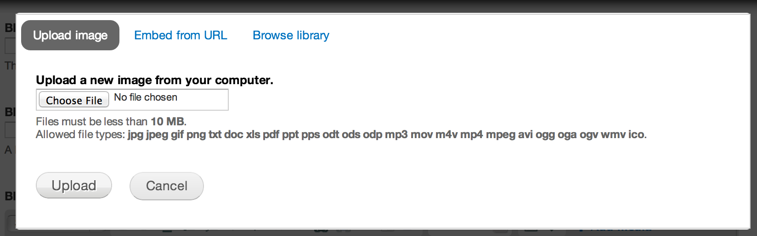
Add media
You can upload an image, embed a url, or browse your site's library.
Notes:
Tom

Slide 10
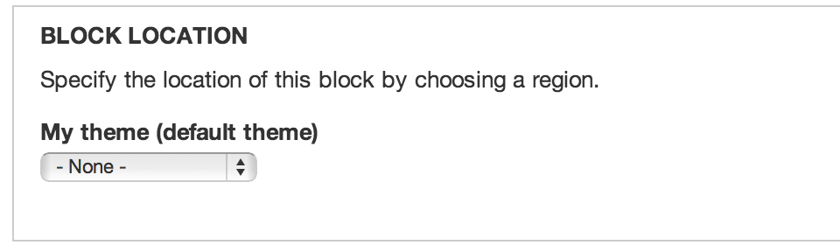
Pick a region for a block
Be sure to select a region for your block to display in.
Notes:
Ok, here’s the list of each of the workshops. We’ll go through each of these a bit. If something sparks your interest or raises suggestions, write it down and we’ll discuss ideas at the end. If something is unclear, feel free to ask and we can try to help answer them.
Later, I’ll give you the status of each of the workshops. For now, we’ll just talk about what the workshops are.

Slide 11
Visibility settings
You can change who gets to see your block and on what pages.
Notes:
Ok, here’s the list of each of the workshops. We’ll go through each of these a bit. If something sparks your interest or raises suggestions, write it down and we’ll discuss ideas at the end. If something is unclear, feel free to ask and we can try to help answer them.
Later, I’ll give you the status of each of the workshops. For now, we’ll just talk about what the workshops are.

Slide 12
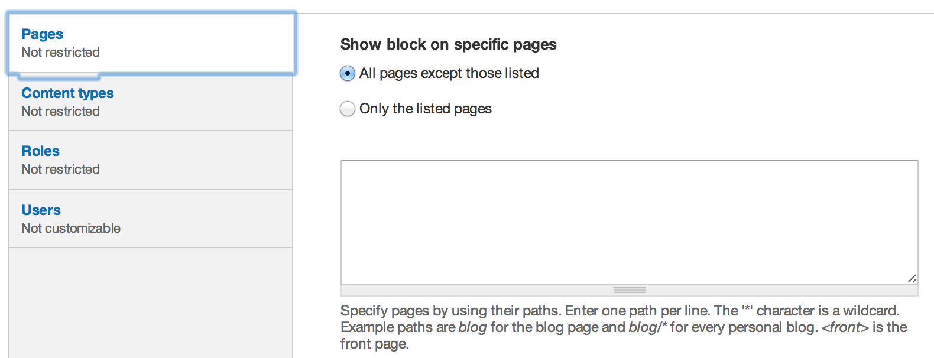
Page visibility
Can be either a list of select pages not to show the block on, or a list of select pages to show the block on.
Notes:
Ok, here’s the list of each of the workshops. We’ll go through each of these a bit. If something sparks your interest or raises suggestions, write it down and we’ll discuss ideas at the end. If something is unclear, feel free to ask and we can try to help answer them.
Later, I’ll give you the status of each of the workshops. For now, we’ll just talk about what the workshops are.

Slide 13
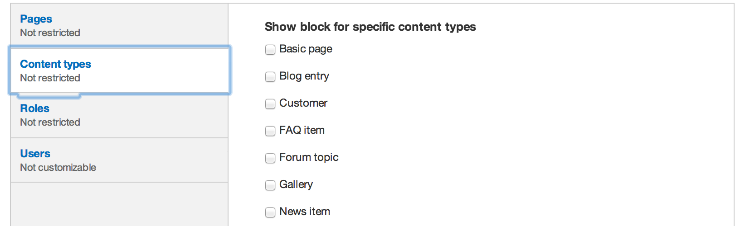
Content type visibility
Which types of content pages will the block be visible on.
Notes:
Ok, here’s the list of each of the workshops. We’ll go through each of these a bit. If something sparks your interest or raises suggestions, write it down and we’ll discuss ideas at the end. If something is unclear, feel free to ask and we can try to help answer them.
Later, I’ll give you the status of each of the workshops. For now, we’ll just talk about what the workshops are.

Slide 14
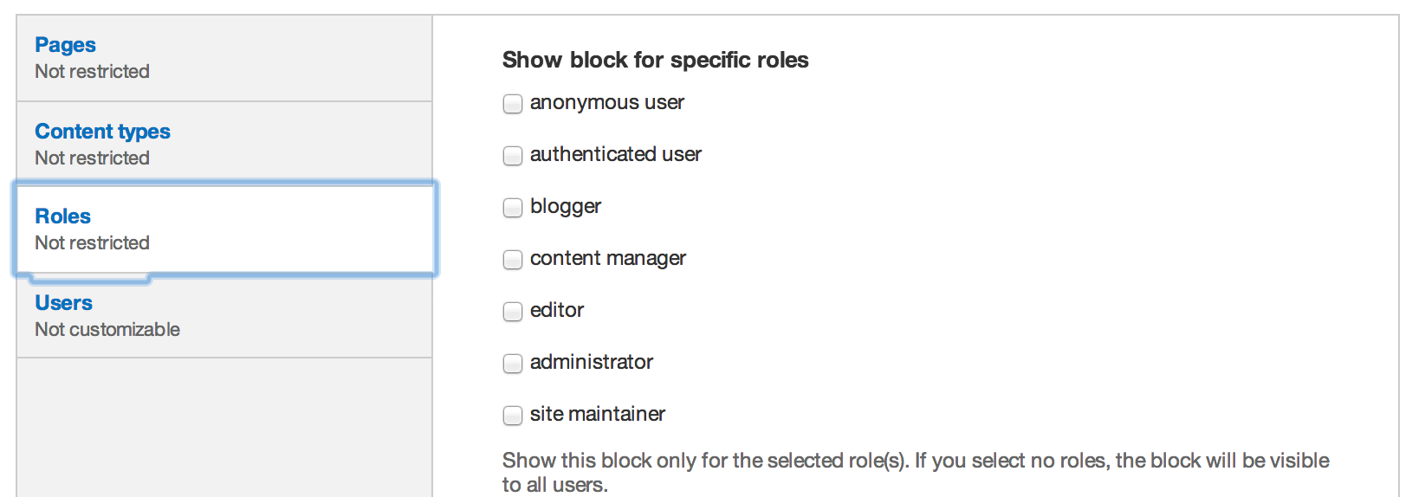
Roles visibility
Which type of users can see your block.
Notes:
Ok, here’s the list of each of the workshops. We’ll go through each of these a bit. If something sparks your interest or raises suggestions, write it down and we’ll discuss ideas at the end. If something is unclear, feel free to ask and we can try to help answer them.
Later, I’ll give you the status of each of the workshops. For now, we’ll just talk about what the workshops are.

Slide 15
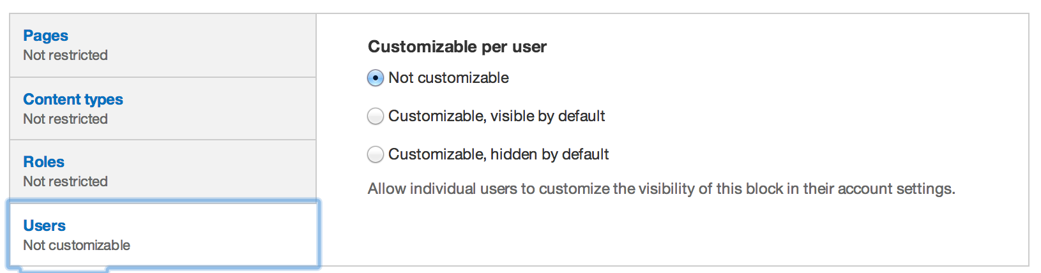
Users visibility
Whether users can choose to see your block.

